Slide 1

Umut Mehmet ERDEM 200102002025
Arda DERİCİ 200102002051
Mehmet Salih TURHAN 200102002053
Mehmet Fırat AYDIN 210102002025
Ahmet Ali TİLKİCİOĞLU 210102002163

Slide 2
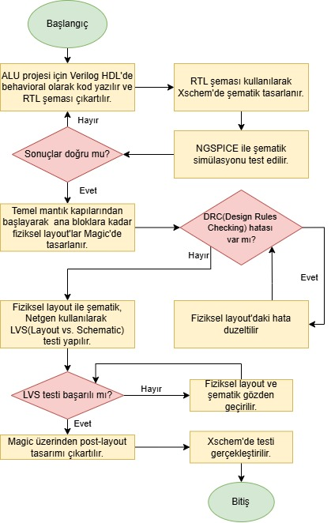
DESIGN APPROACH

Slide 3
Register Transfer Level (RTL) Output

Slide 4
ArIthmetIc UnIt SchematIc

Slide 5
Array MultIplIer SchematIc

Slide 6
Ripple Carry Adder (RCA) Schematic

Slide 7
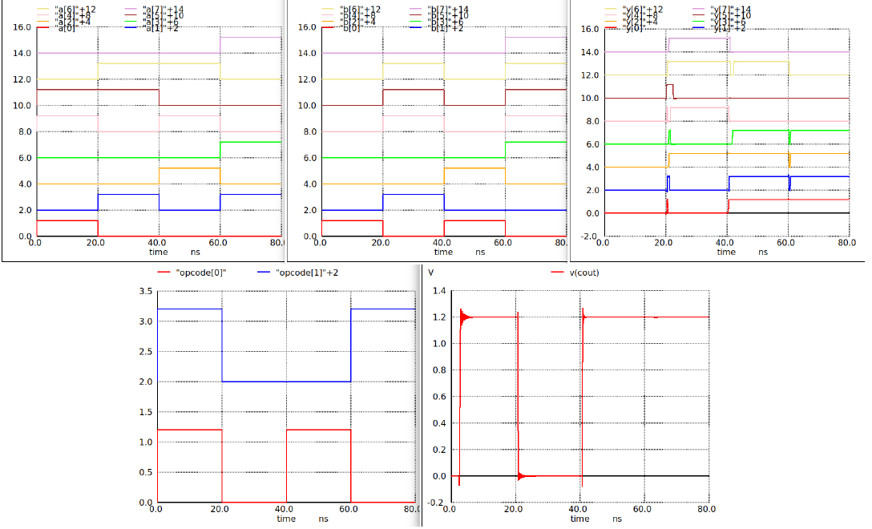
ArIthmetIc UnIt SImulatIon Results

Slide 8
LogIcal UnIt SchematIc

Slide 9
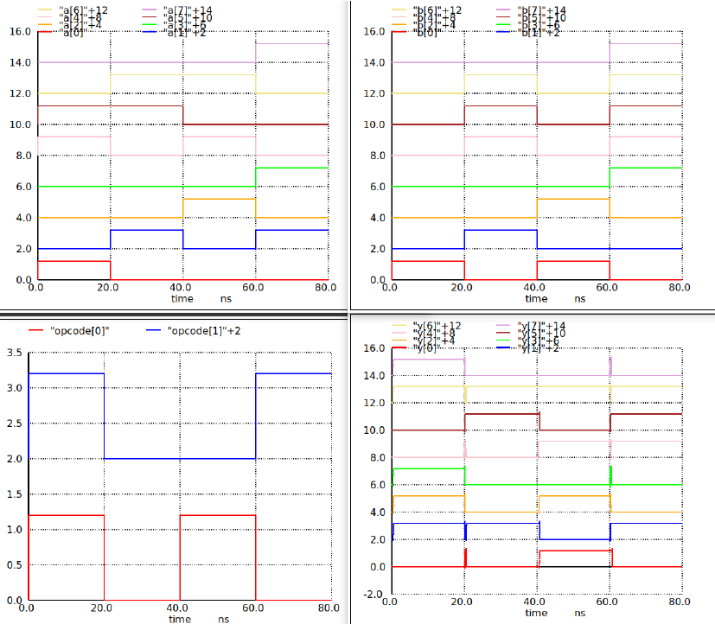
LogIcal UnIt SImulatIon Results

Slide 10
Shifter Unit Schematic and Simulation Results

Slide 11
Control UnIt SchematIc

Slide 12
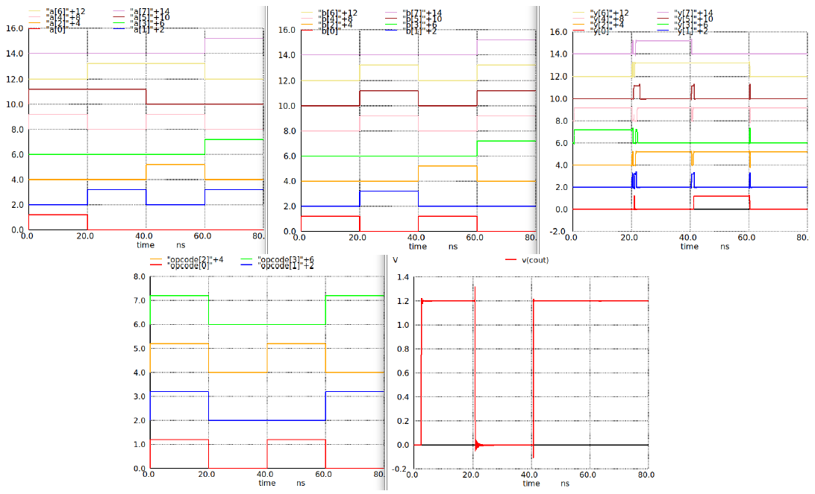
Control UnIt SImulatIon Results

Slide 13
ALU SchematIc

Slide 14
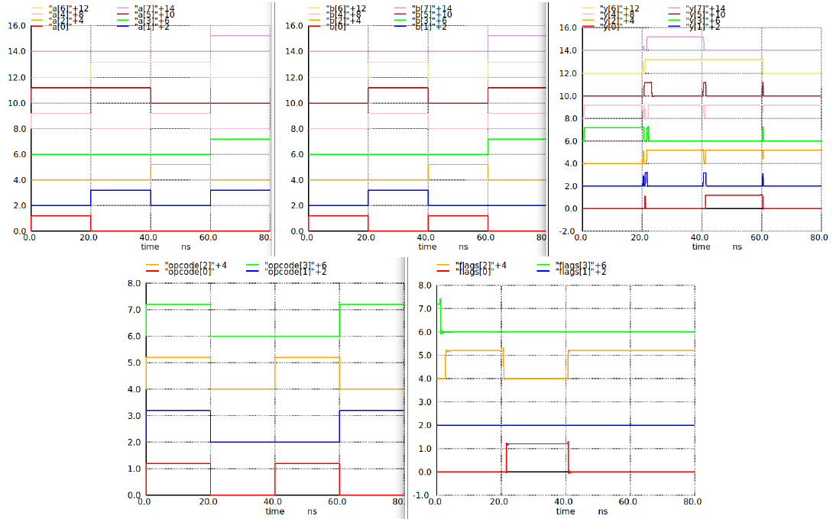
ALU SImulatIon Results

Slide 15
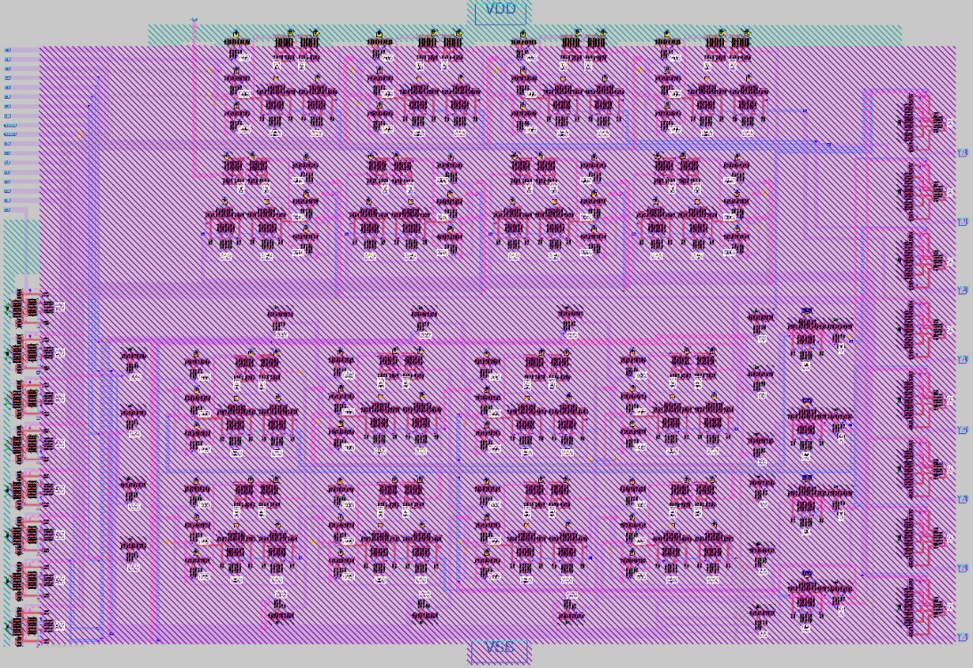
ArIthmetIc UnIt Layout DesIgn

Slide 16
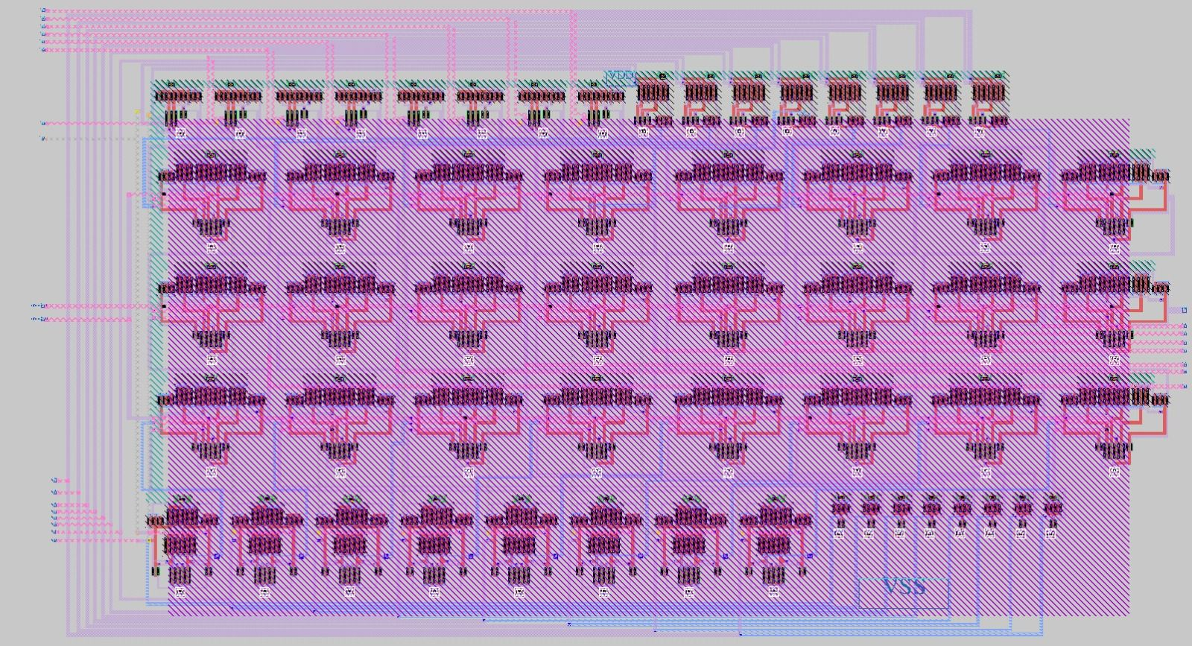
LogIcal UnIt Layout DesIgn

Slide 17
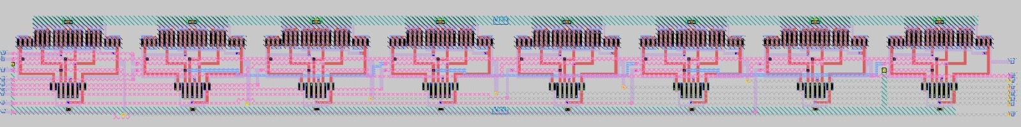
ShIfter UnIt Layout DesIgn

Slide 18
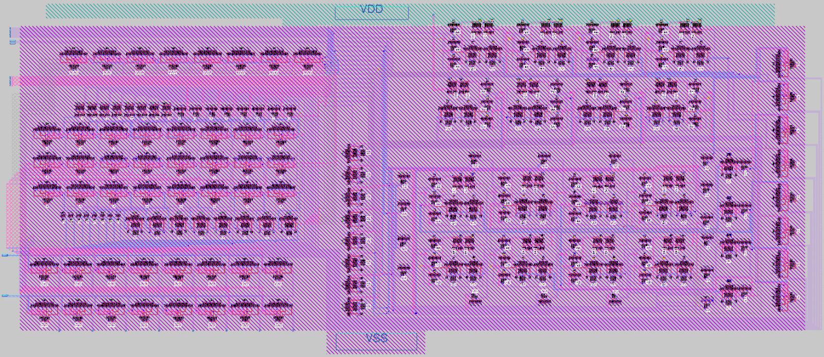
Control UnIt Layout DesIgn

Slide 19
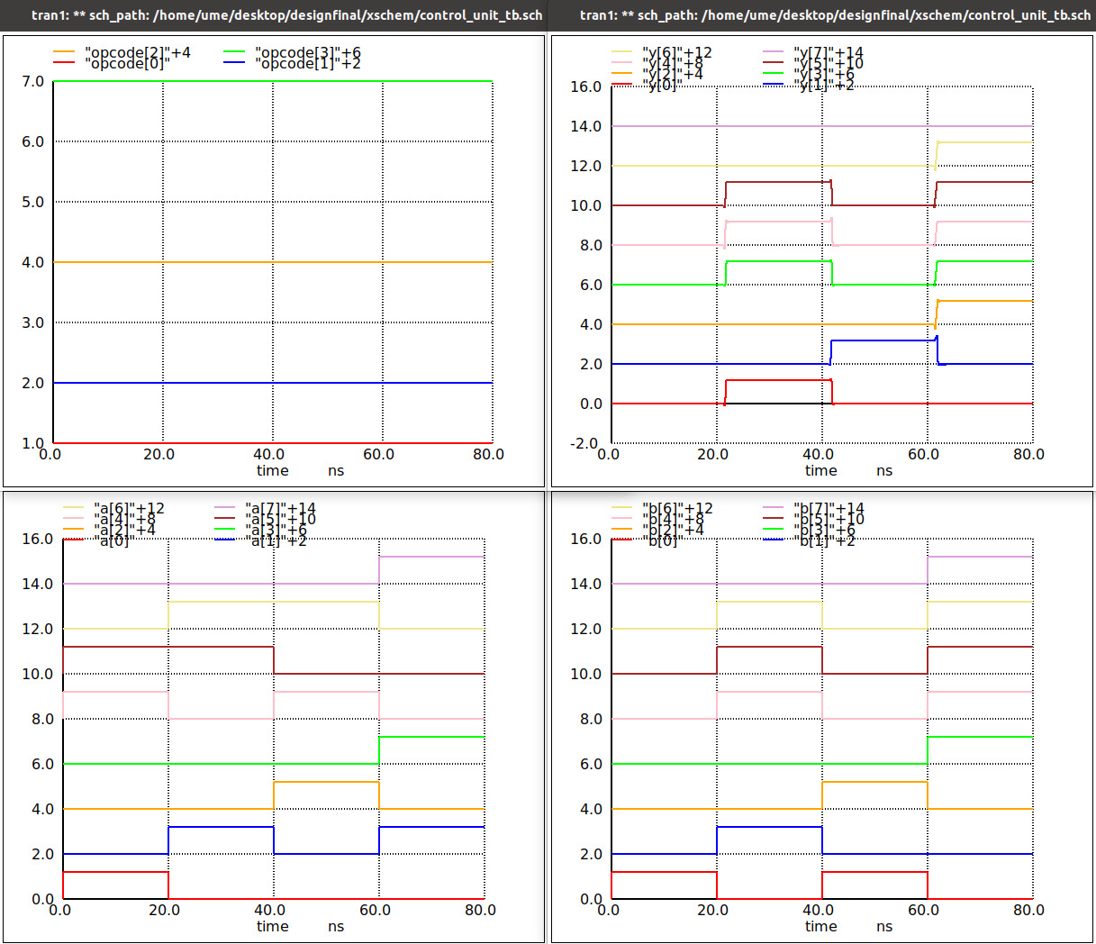
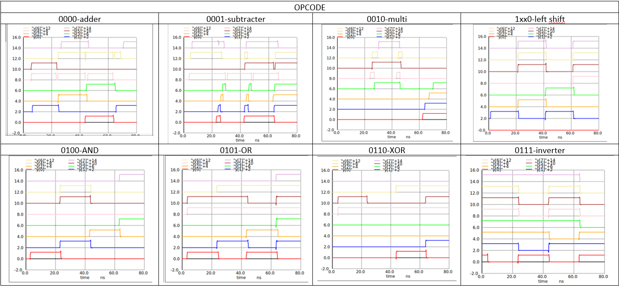
Control Unit Layout Simulation Output

Slide 20
Project Challenges and SolutIons
CHALLENGES SOLUTIONS
Design Complexity Designing a simple and understandable block diagram suitable for Verilog code
Timing Synchronization optimized the sizes of the CMOS transistors
Simulation Accuracy Simulation control of RTL, schematic and post-layout designs
Integration of Sub-units Hierarchical design of ALU circuit

Slide 21
Thank you for listening to us.
Umut Mehmet ERDEM
ARDA DERİCİ
MEHmet SALİH TURHAN
AHMET ALİ TİLKİCİOĞLU
MEHMET FIRAT AYDIN

